Slide 1
1 Intro to Problem Solving and Python
Instructor: Raed Karim
Email: raed.karim@sheridancollege.ca
Course: PROG12583

Slide 2
Python Fundamentals
Objectives
At the end of this module, students will be able to:
Define computers, computer programs, how computers work, the different types of software.
Design programs and solve problems using pseudocode and flowcharts.
Analyze python programming language.
Write computer programs using IDE (Visual Studio Code).
Identify an alternative to the IDE to write programs.

Slide 3
Intro to the course Part - 1

Slide 4
Introductions
Introductions:
Know your professor
Let me know about you!

Slide 5
Introductions
Class rules:
Attend all classes PLEASE!
Arrive on time
Class has 15 mins break after the 1st hour
Two parts: a lecture followed by hands on practice (using visual studio code)
Ask questions ! Get engaged ! practice and practice!

Slide 6
Introductions
Contact Info:
Dr. Raed Karim.
Email: raed.karim@sheridancollege.ca
You can talk to me in class or email me to book an appointment to meet
Use your Sheridan email address
When sending an email, tell your name, student # and your section #
You can send your email from slate or using outlook

Slide 7
Introductions
Evaluations:
Mid Term Exam (week 6): 30%
Final Exam (week 14): 30%
4 Assignments: 30%
5 In class quizzes – 10%
Total: 100%
To pass the course, students must achieve a 50% weighted average across the tests and the exams and at least 50% overall in the course.
Students must submit/complete all assignments, in-class activities and projects by the scheduled due date and write all tests on the specified date/time. Exceptions will only be made under extraordinary circumstances.

Slide 8
Introductions
Course objective:
To learn how to write computer programs to solve real problems…
To learn how to design, implement and debug a program…
To learn the best programming practices and skills through hands on training…
To learn python programming language…

Slide 9
Introductions
Course outline and course plan
They are posted on slate
Access them so we review the course details
Q/A session..

Slide 10
Intro to computer programming Part - 2

Slide 11
Introductions
Computers are designed to do any job that their programs tell them to do.
A program is a set of instructions that a computer follows to perform a task. For example: Microsoft Word and PowerPoint
Programs are commonly referred to as software.
Programmers or Software Developers are the individuals that create computer software.
They have the training and skill to design, create, and test computer programs.
Discussion: What software have you used?

Slide 12
Introductions
Discussion:
What are some of the fields in which computer programs are used?

Slide 13
Introductions
Software
Everything a computer does is controlled by software.
Two categories of software:
System software
Application software

Slide 14
Introductions
System Software
Programs that control and manage the basic operations of a computer are referred to as system software.
Includes the following types:
Operating System controls the internal operations of the computer’s hardware and manages all of the devices connected to the computer.
Utility Programs perform a specialized task that enhances the computer’s operation or safeguards data.
Software Developments Tools are programs that are used to create, modify, and test software.

Slide 15
Introductions
Application Software
Programs that people normally spend most of their time running on their computers performing everyday tasks are referred to as application software.
For example:
Word processing
Spreadsheet
Database
Presentation

Slide 16
Introductions
How a program works
A computer’s CPU can only understand instructions that are written in machine language. Because people find it very difficult to write entire programs in machine language, other programming languages have been invented.

Slide 17
Introductions
How a program works
C P U is the most important component in a computer
C P U is not a brain
C P U is not smart
C P U is an electronic device that is designed to do specific things.

Slide 18
Introductions
C P U is designed to perform the following operations:
Read a piece of data from main memory
Adding two numbers
Subtracting one number from another number
Multiplying two numbers
Dividing one number by another number
Moving a piece of data from one memory location to another
Determining whether one value is equal to another value

Slide 19
Introductions
C P U only understands instructions written in machine language
Machine language instructions are written in 1s and 0s
The entire set of instructions that a C P U can execute is known as the C P U ’ s instruction set
Each brand of microprocessors (Intel, A M D, and Motorola) has a unique instruction set

Slide 20
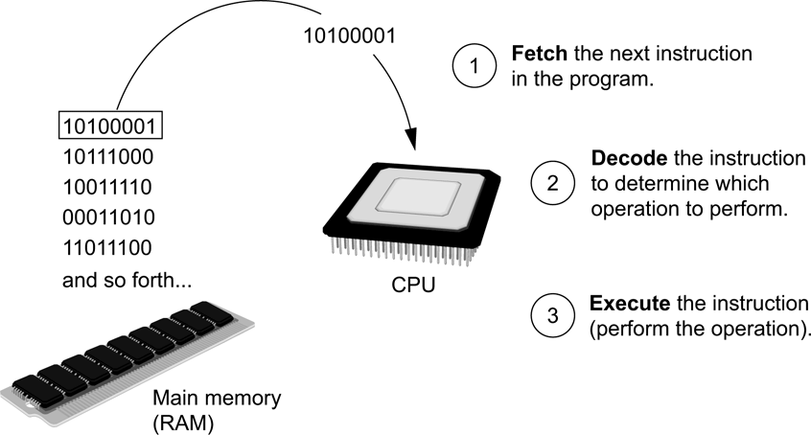
Introductions
Fetch-decode-execute cycle is the term used when the C P U executes the instructions in a program.
The cycle consist of three steps:
Fetch: fetching involves receiving an instruction. The instruction is represented as a series of numbers and is passed to the CPU from the RAM. Each instruction is only one small part of any operation, so the CPU needs to know which instruction comes next. The current instruction address is held by a program counter (PC). The PC and instructions are then placed into an Instruction Register (IR).
Decode: Once an instruction is fetched and stored in the IR, the CPU passes the instruction to a circuit called the instruction decoder. This converts the instruction into signals to be passed through to other parts of the CPU for action.
Execute: In the final step, the decoded instructions are sent to the relevant parts of the CPU to be completed.

Slide 21
Introductions
From Machine Language to Assembly Language
Computers only understand machine language
Machine language is difficult to write
Assembly language uses short words that are known as mnemonics
Assembler is used to translate an assembly language program to machine language

Slide 22
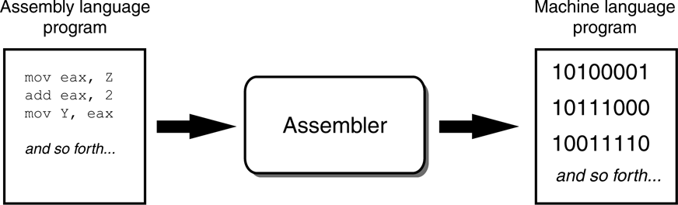
Introductions
An assembler translates an assembly language program to a machine language program

Slide 23
Introductions
High-Level Languages
Assembly language is referred to as a low-level language High-level languages allow you to create powerful and complex programs without knowing how the C P U works, using words that are easy to understand.
For example:
Java, C++, Python, Visual Basic, Ada, Fortran
Do you know of any other high-level computer programming languages?

Slide 24
Introductions
Key Words, Operators, and Syntax: an Overview
Keywords or reserved words have specific meaning and purpose in the programming language
Operators perform various operations on data
Syntax is a set of rules that must be strictly followed when writing a program
Statements are individual instructions written in a programming language

Slide 25
Introductions
Compilers and Interpreters
The statements written in a high-level language are called source code or simply code
Source code is translated to machine language using a compiler or an interpreter
Syntax error is a mistake such as a:
Misspelled word
Missing punctuation character
Incorrect use of an operator

Slide 26
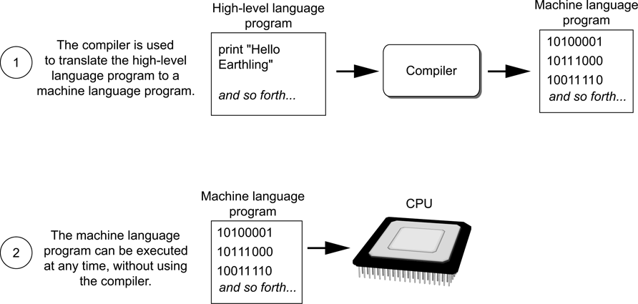
Introductions
Compiler is a program that translates a high-level language program into a separate machine language program.
Compiling a high-level program and executing it

Slide 27
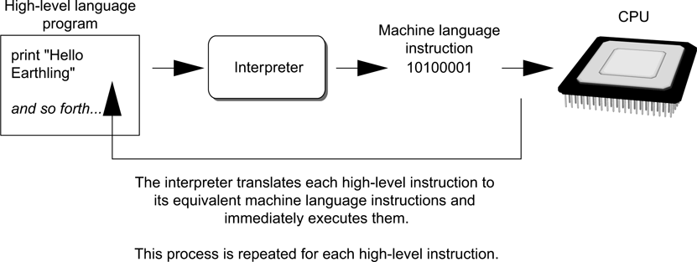
Introductions
An interpreter is a program that both translates and executes the instructions in a high-level language program.
Executing a high-level program with an interpreter

Slide 28
Problem solving and program design Part - 3

Slide 29
Introductions
Designing a program
The first step in programming is designing – flow charts and pseudocode help with this process.
Next, the code is written.
All code must be cleared of all syntax errors.
After the executable is created, it can be checked for logic errors.
If logic errors exist, the program must be debugged.

Slide 30
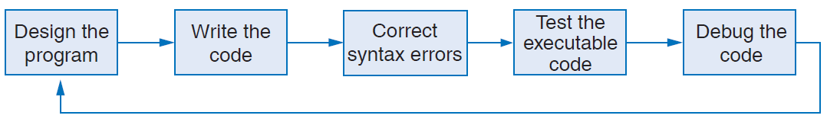
Introductions
Designing a program
The purpose of Programming Logic and Design is to focus on Flow charts and Pseudocode.
The design is the foundation of a good program.
The program development cycle

Slide 31
Introductions
Designing a program
Two steps in designing a program:
Understand the tasks that the program is to perform.
Learning what the customer wants.
Determine the steps that must be taken to perform the task.
Create an algorithm, or step-by-step directions to solve the problem.
Use flow charts and/or pseudocode to solve.

Slide 32
Introductions
Designing a program
Pseudocode
Fake code used as a model for programs
No syntax rules
Well written pseudocode can be easily translated to actual code
Display "Enter the number of hours"
Input hours
Display "Enter the hourly pay rate"
Input payRate
Set grossPay = hours * payRate
Display "The gross pay is $", grossPay

Slide 33
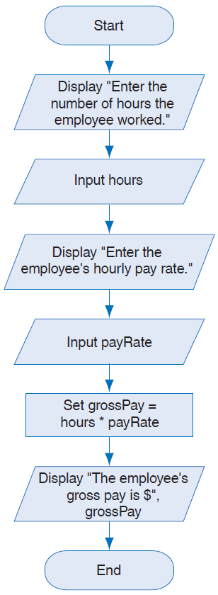
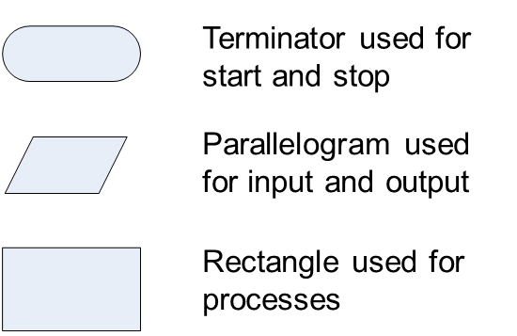
Introductions
Designing a program
Flow chart for the pay calculating program
Flow charts
A diagram that graphically depicts the steps that take place in a program

Slide 34
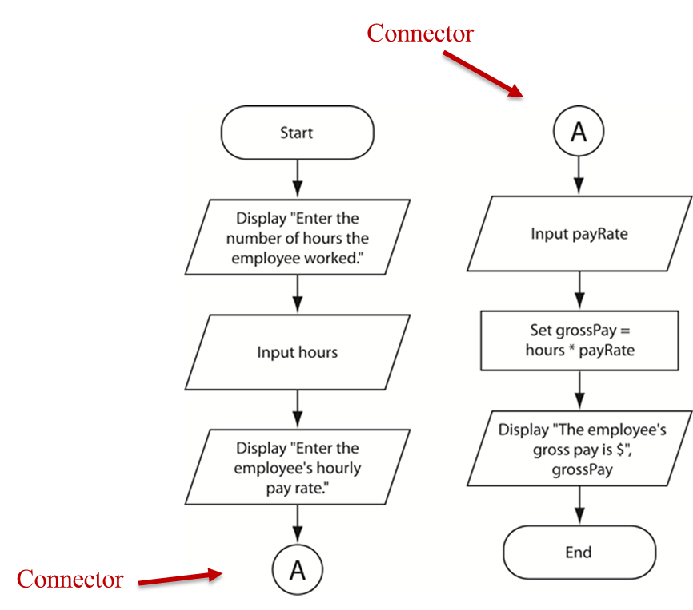
Introductions
Designing a program
Flow chart Connector Symbol
Use connectors to break a flow chart into two or more smaller flow charts and placing them side-by-side on the page.

Slide 35
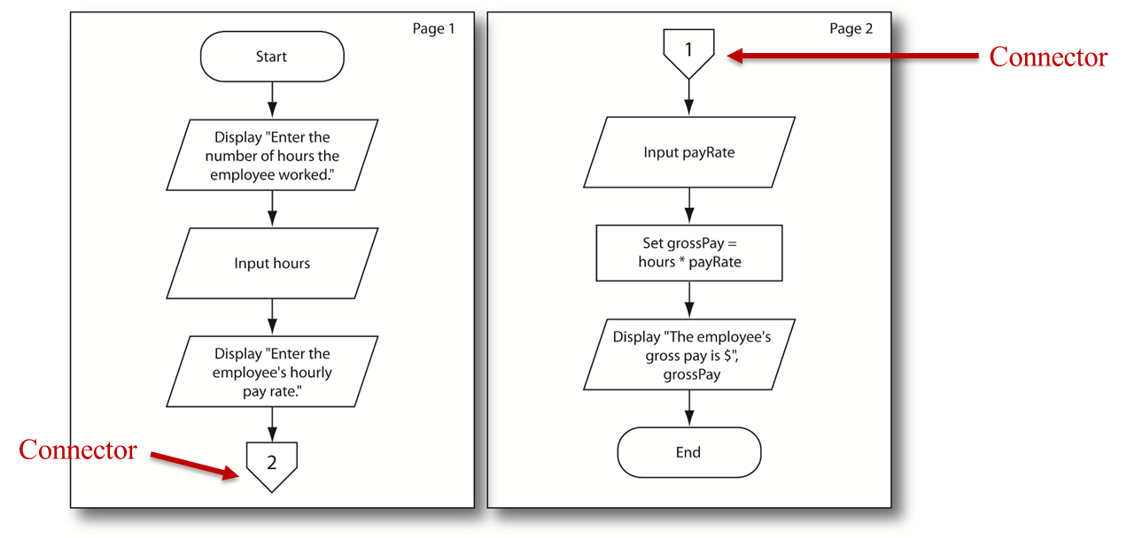
Introductions
Designing a program
Off-Page Connector Symbol
To connect flow charts on different pages

Slide 36
Introductions
Designing a program
Output – data that is generated and displayed
Input – data that a program receives
Variables – storage locations in memory for data
Computer programs typically follow 3 steps
Input is received
Some process is performed on the input
Output is produced

Slide 37
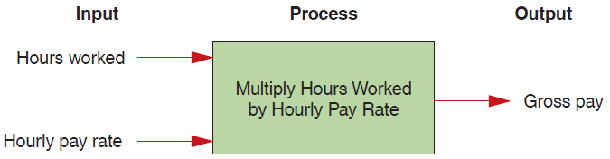
Introductions
Designing a program
Input, Processing, and Output of a Pay Calculating program:

Slide 38
Intro to python Part - 4

Slide 39
Introductions
What is python?
Python is a powerful programming language that lets you develop programs in less time and with less code than other programming languages.
Python is a great language for learning how to program.
Python timeline shows that Python 2 became available in the year 2000. This was replaced by Python 3 in 2008.
Python 3 isn’t backward compatible. That means that Python 3 can’t run most programs written for Python 2. Conversely, Python 2 isn’t forward compatible. That means that it can’t run most programs written for Python 3.

Slide 40
Introductions
What is python?
Python supports a wide range of applications.
Python is used by many successful companies.
Python is open source, which means that its source code is available to the entire Python community.
Python is much closer to plain English than other programming languages.
You write a Python program with far less code than the same program would take in C++, Java, C#, and yet, you can learn most of the concepts and skills that you need.

Slide 41
Introductions
What is python?
Syntax differences between Python and Java Some Java code:
private static double calculateFutureValue( double monthlyInvestment, double monthlyRate, int months) {
double futureValue = 0.0; for (int i = 1; i <= months; i++) { futureValue =
(futureValue + monthlyInvestment) * (1 + monthlyRate); } return futureValue;
}
Python code that works the same
def calculateFutureValue(monthlyInvestment, monthlyRate, months):
futureValue = 0.0
for i in range(months):
futureValue =(futureValue + monthlyInvestment) * (1 + monthlyRate)
return futureValue

Slide 42
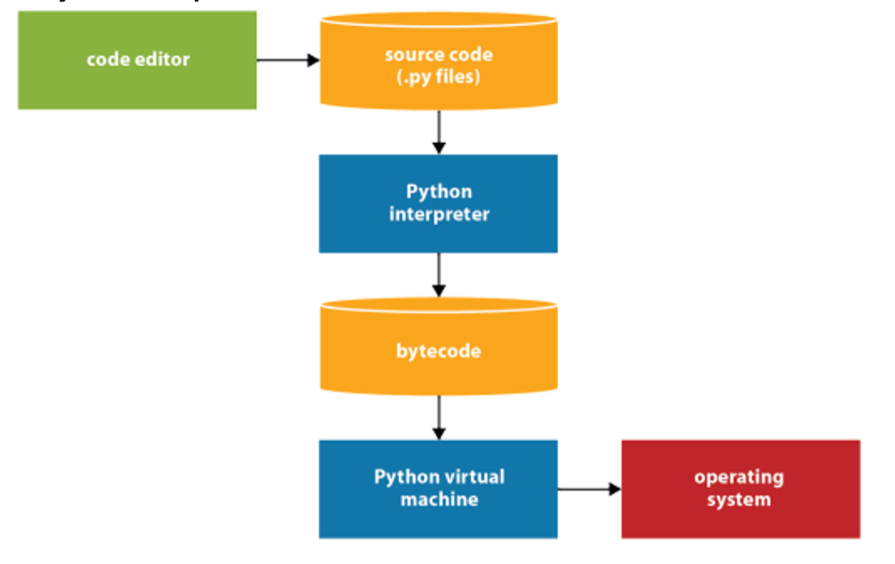
Introductions
How python runs source code?
Step 1 The programmer uses a text editor or IDE to enter and edit the source code. Then, the programmer saves the source code to a file with a .py extension.
Step 2 The source code is compiled by the Python interpreter into bytecode.
Step 3 The bytecode is translated by the Python virtual machine into instructions that can interact with the operating system of the computer.

Slide 43
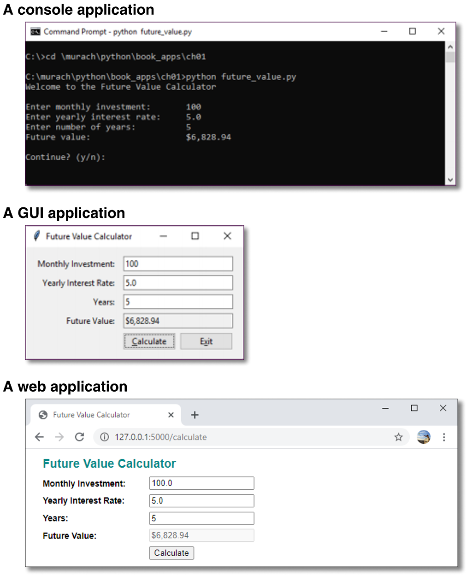
Introductions
Python applications
A console application is a desktop application that uses the console to interact with the user.
A GUI application is an application that uses a graphical user interface (GUI) to interact with the user.
A web application typically gets requests from a web browser, processes them on a web server, and returns the responses to the web browser.

Slide 44
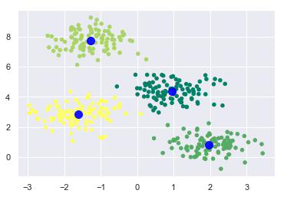
Introductions
Python applications
In recent years, we have seen a great interest in using python as a primary tool in Machine Learning (a branch of Artificial Intelligence) applications.
Some of the important python libraries that are used for the machine learning are OpenCV, NumPy and TensorFlow. These libraries help in data analysis, face recognition, speech recognition and other applications.

Slide 45
Installing visual studio code (the Python IDE) Part - 4

Slide 46
Introductions
What is IDE?
An integrated development environment (IDE) is a software suite that consolidates basic tools required to write and test software.
Developers use numerous tools throughout software code creation, building and testing.
Without an IDE, a developer must select, deploy, integrate and manage all of these tools separately.
An IDE brings many of those development-related tools together as a single framework, application or service.
The IDE is designed to simplify software development and can identify and minimize coding mistakes and typos.

Slide 47
Introductions
Why IDEs are important?
The following are some reasons why developers use IDEs:
Code editing automation
Syntax highlighting
Intelligent code completion
Refactoring support
Compilation
Version control
Visual programming
Testing
Debugging

Slide 48
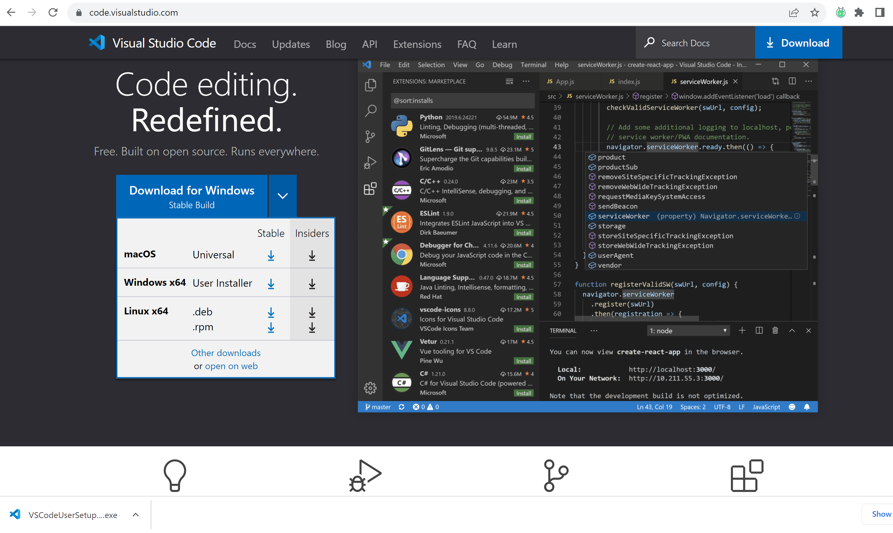
Introductions
Visual studio code downloads
Download visual studio code:
https://code.visualstudio.com/

Slide 49
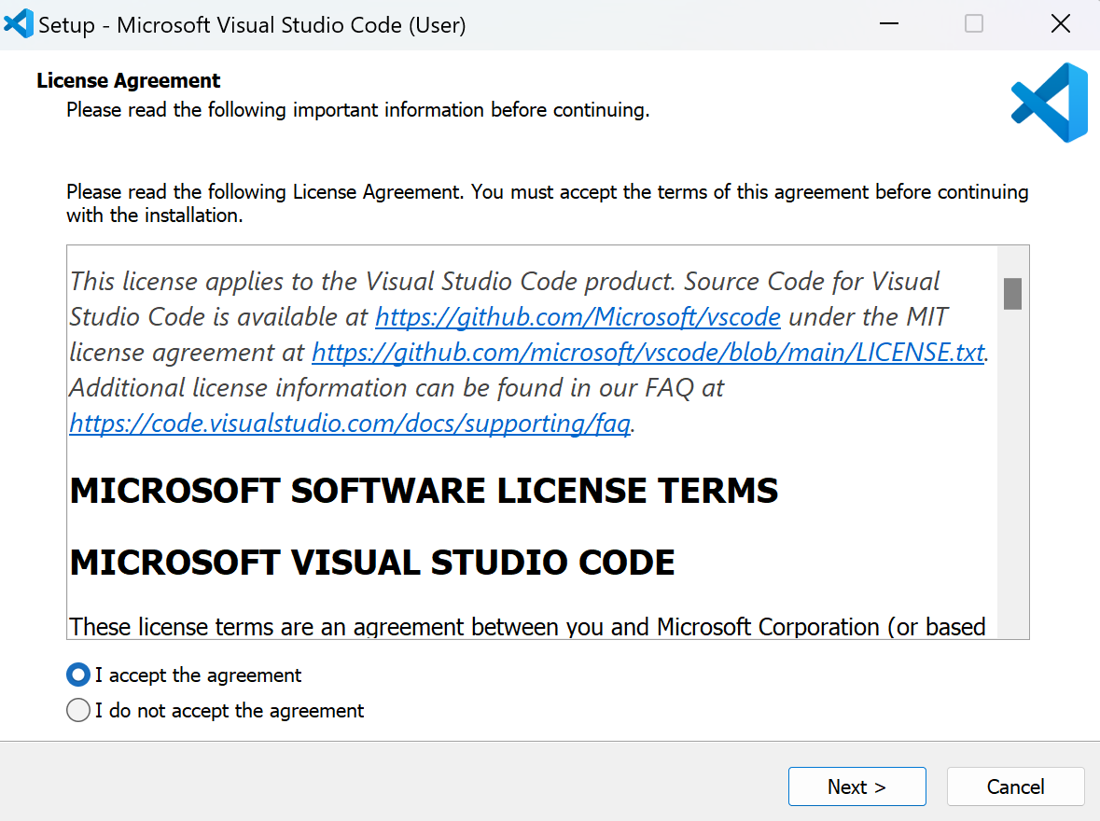
Introductions
Visual studio code downloads
Download visual studio code:
https://code.visualstudio.com/

Slide 50
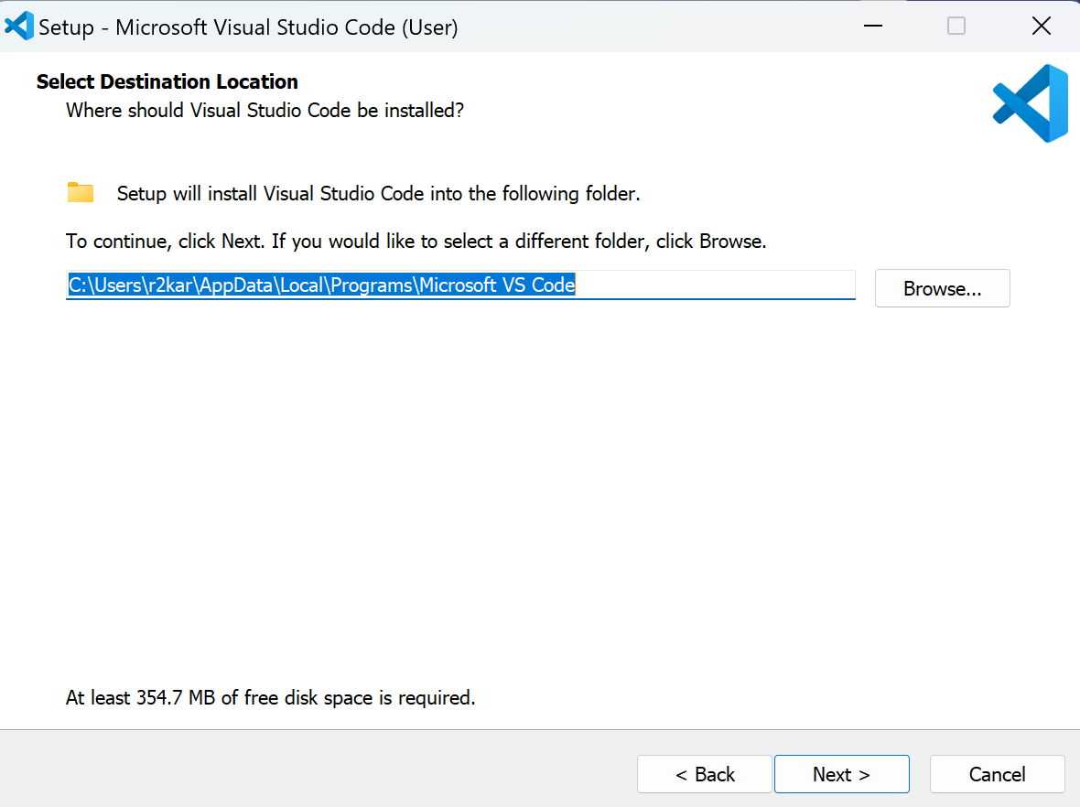
Introductions
Visual studio code downloads
Download visual studio code:
https://code.visualstudio.com/

Slide 51
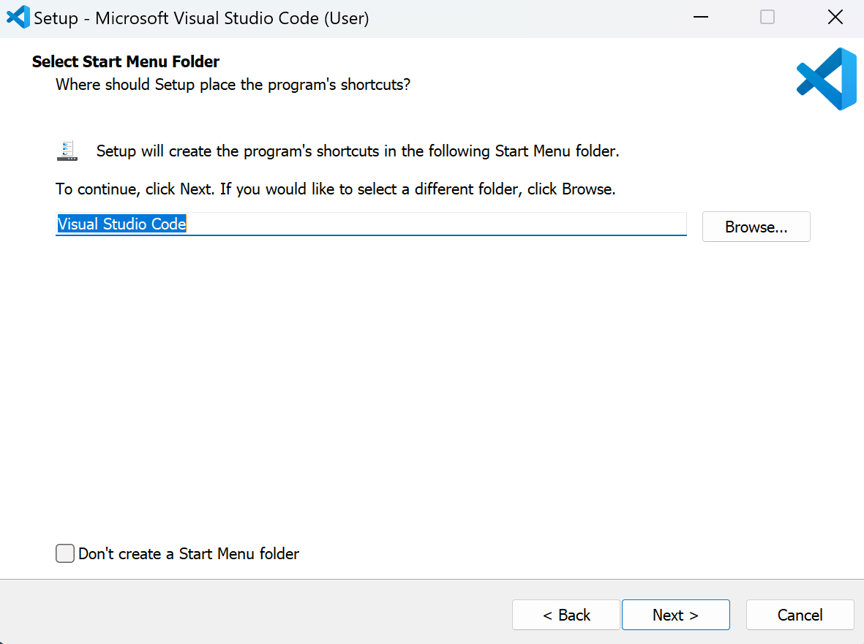
Introductions
Visual studio code downloads
Download visual studio code:
https://code.visualstudio.com/

Slide 52
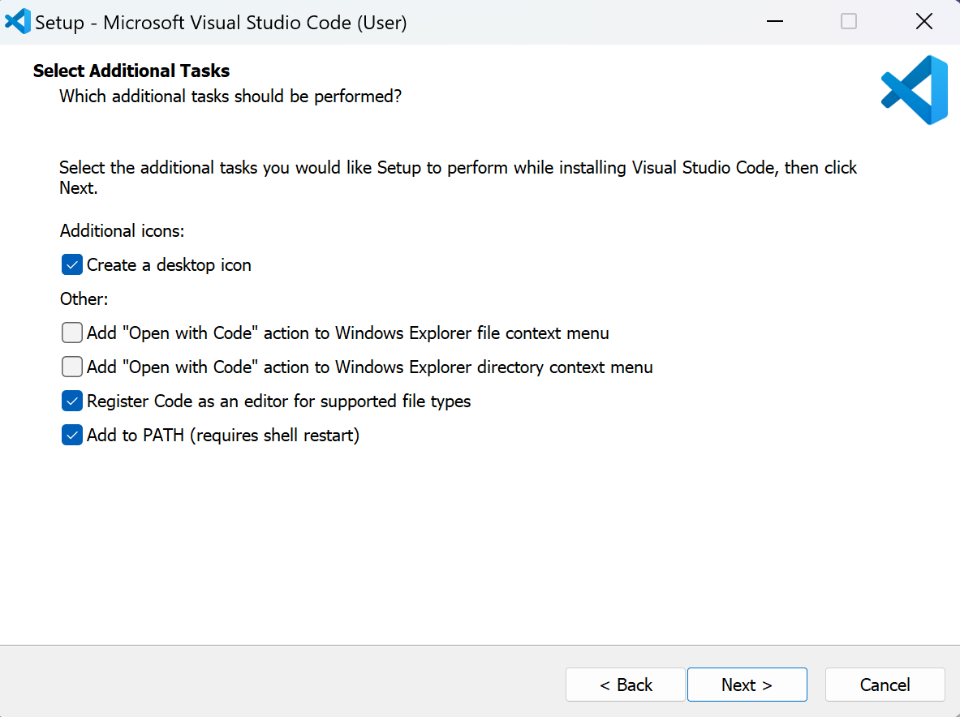
Introductions
Visual studio code downloads
Download visual studio code:
https://code.visualstudio.com/

Slide 53
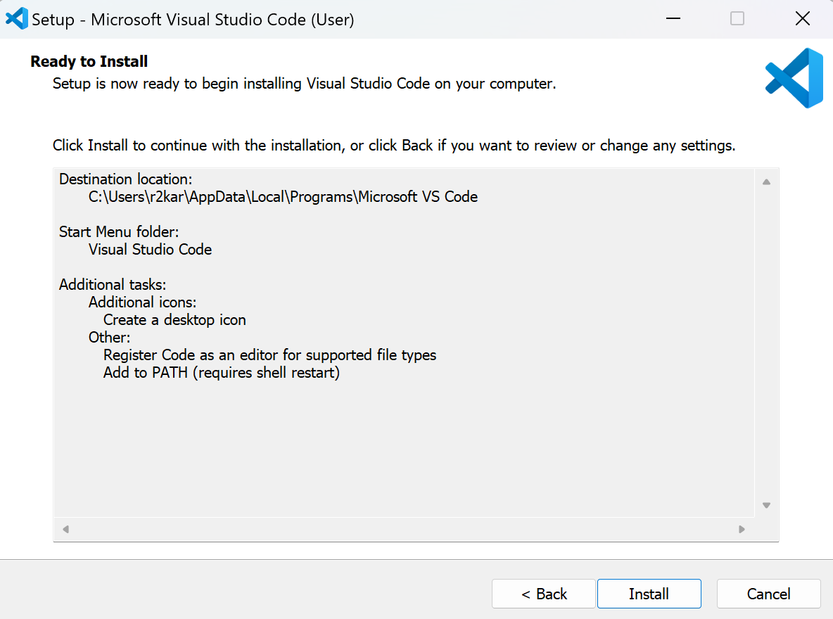
Introductions
Visual studio code downloads
Download visual studio code:
https://code.visualstudio.com/

Slide 54
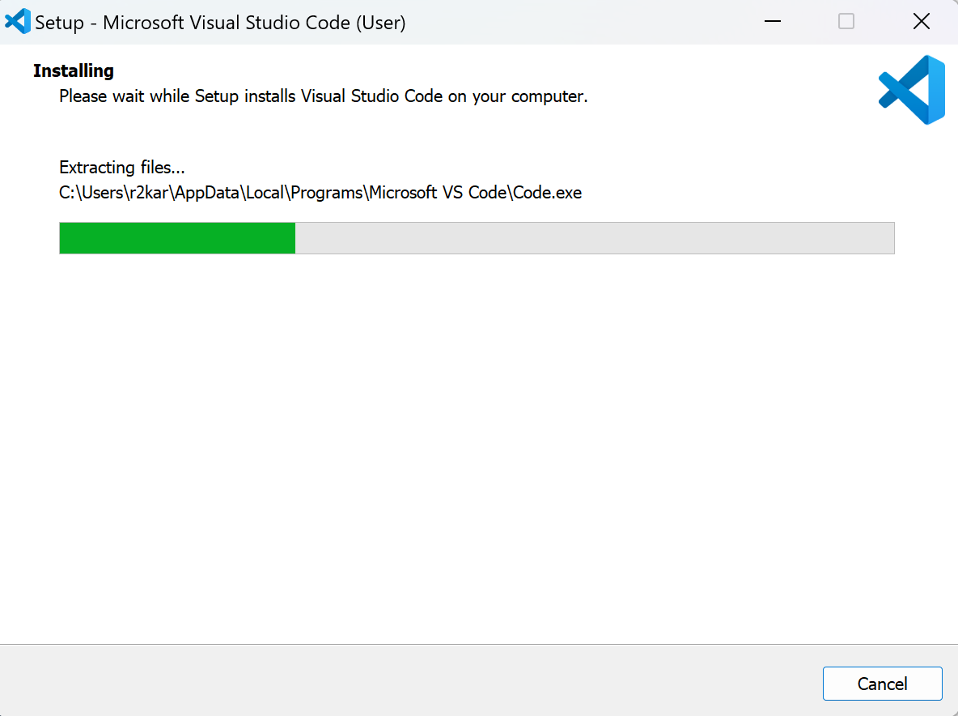
Introductions
Visual studio code downloads
Download visual studio code:
https://code.visualstudio.com/

Slide 55
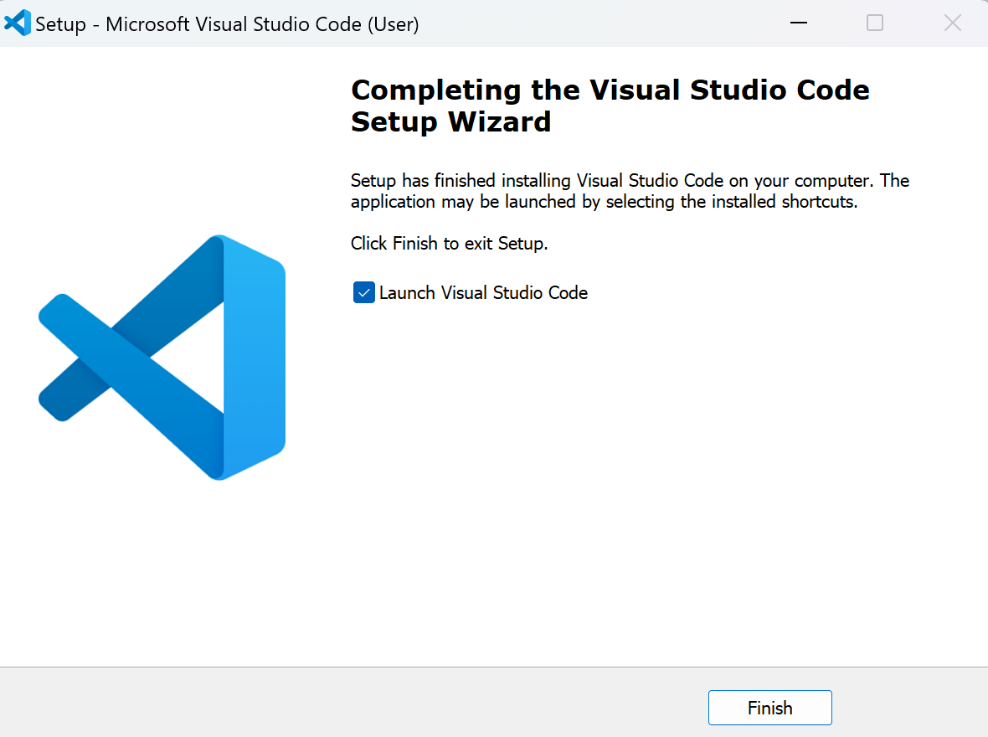
Introductions
Visual studio code downloads
Download visual studio code:
https://code.visualstudio.com/

Slide 56
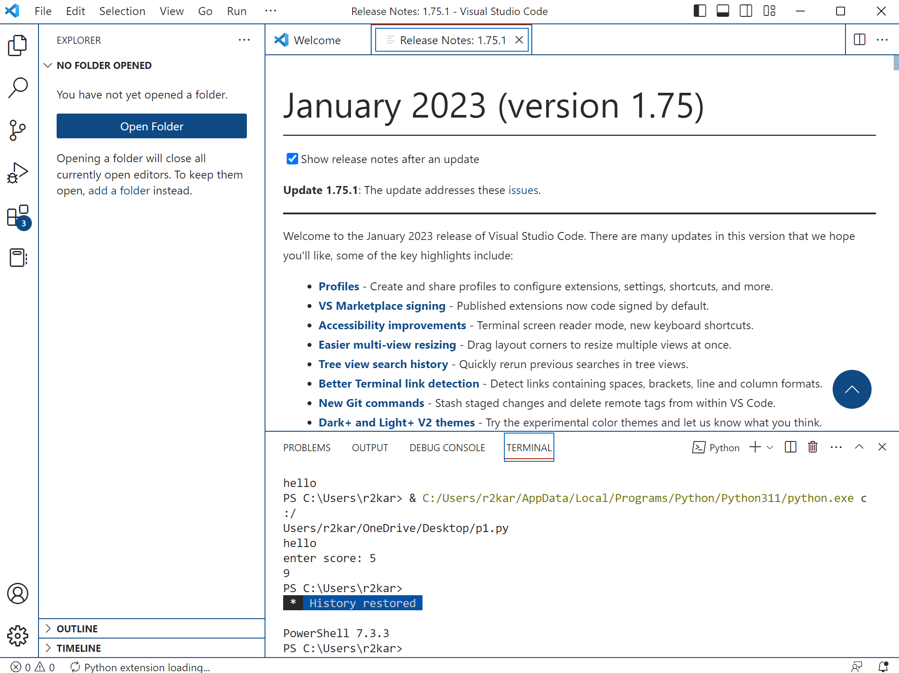
Introductions
Visual studio code downloads
Download visual studio code:
https://code.visualstudio.com/

Slide 57
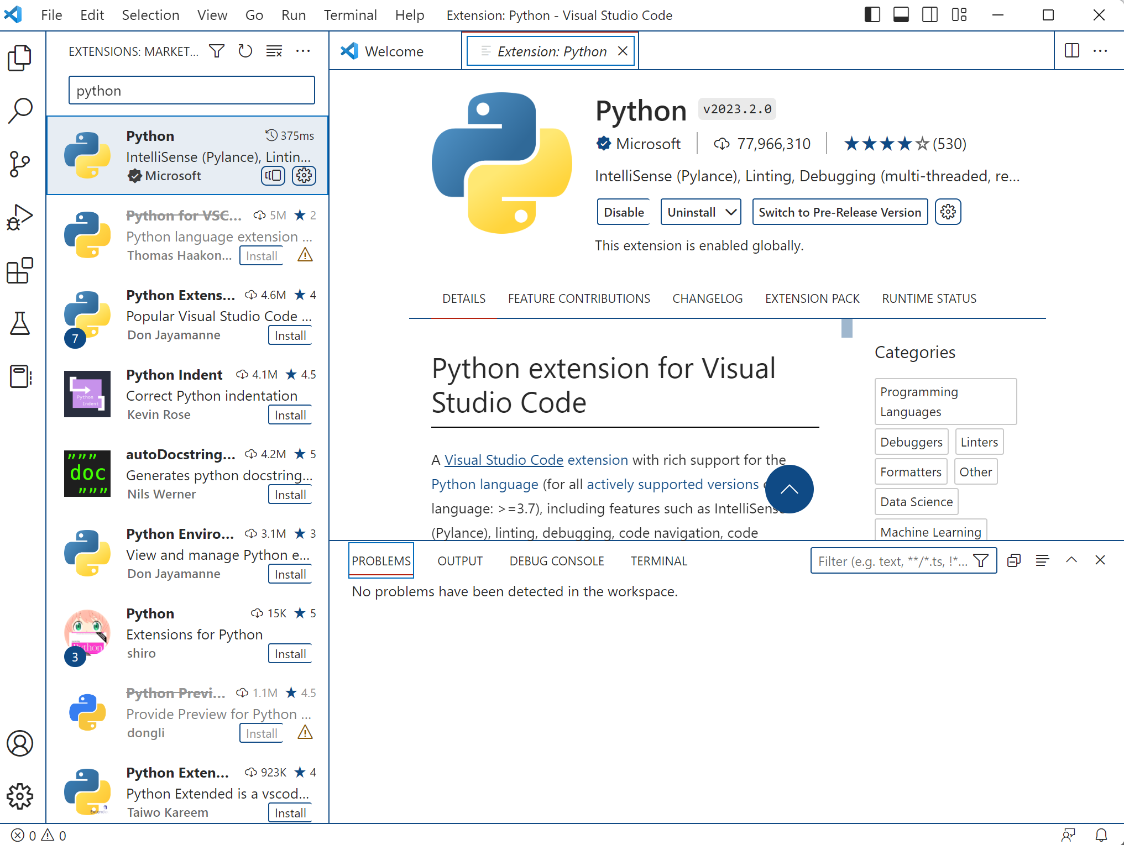
Introductions
Visual studio code downloads
Download visual studio code:
https://code.visualstudio.com/
Adding python extension
For visual studio code.
Click on the Install button
In the editor..
2
1

Slide 58
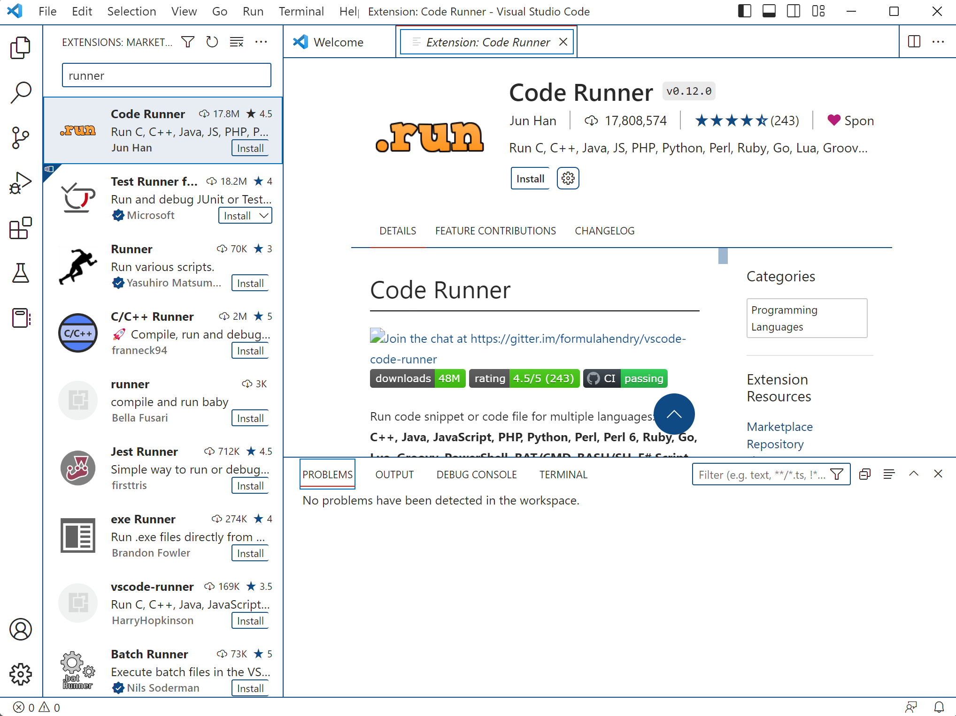
Introductions
Visual studio code downloads
Download visual studio code:
https://code.visualstudio.com/
Adding code runner to display
the code runner icon on top right.
We use it to run our python
programs .
2
3
1

Slide 59
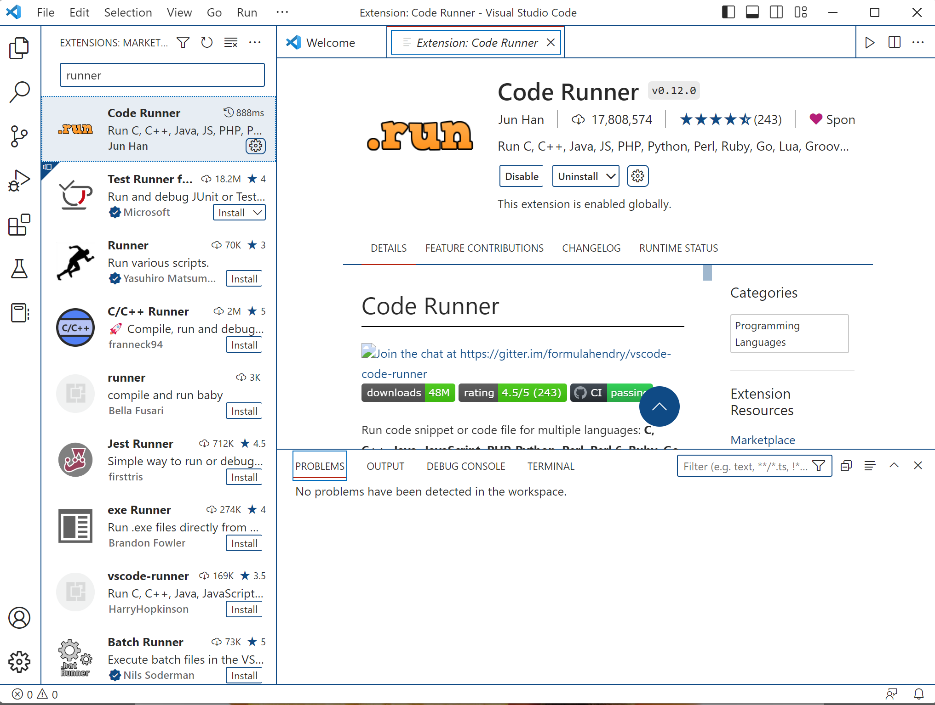
Introductions
Visual studio code downloads
Download visual studio code:
https://code.visualstudio.com/
The code runner icon
is shown on the top right.

Slide 60
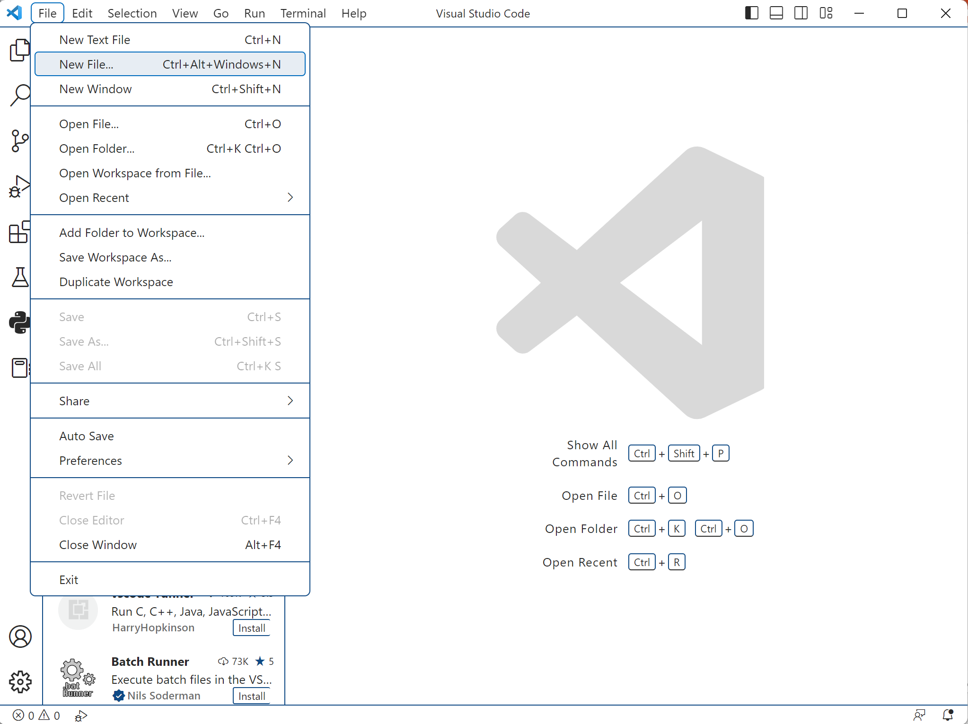
Introductions
Visual studio code downloads
Download visual studio code:
https://code.visualstudio.com/
Now, let’s write a python program
And run it !
First, go to File then select
New File..

Slide 61
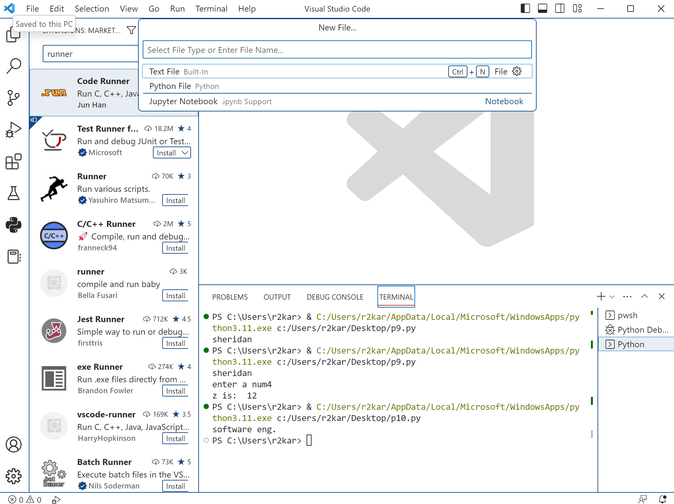
Introductions
Visual studio code downloads
Download visual studio code:
https://code.visualstudio.com/
Select Python File…

Slide 62
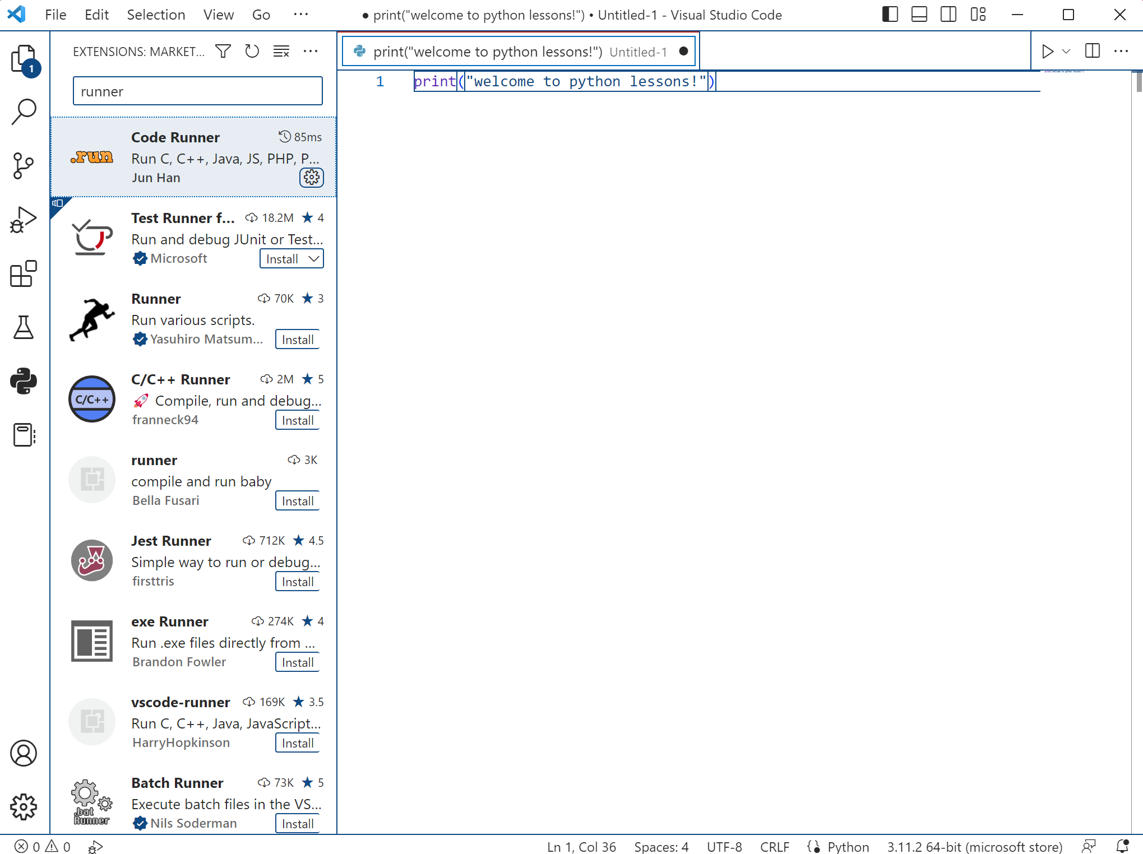
Introductions
Visual studio code downloads
Download visual studio code:
https://code.visualstudio.com/
Start typing your Python code…
Then click the runner icon..

Slide 63
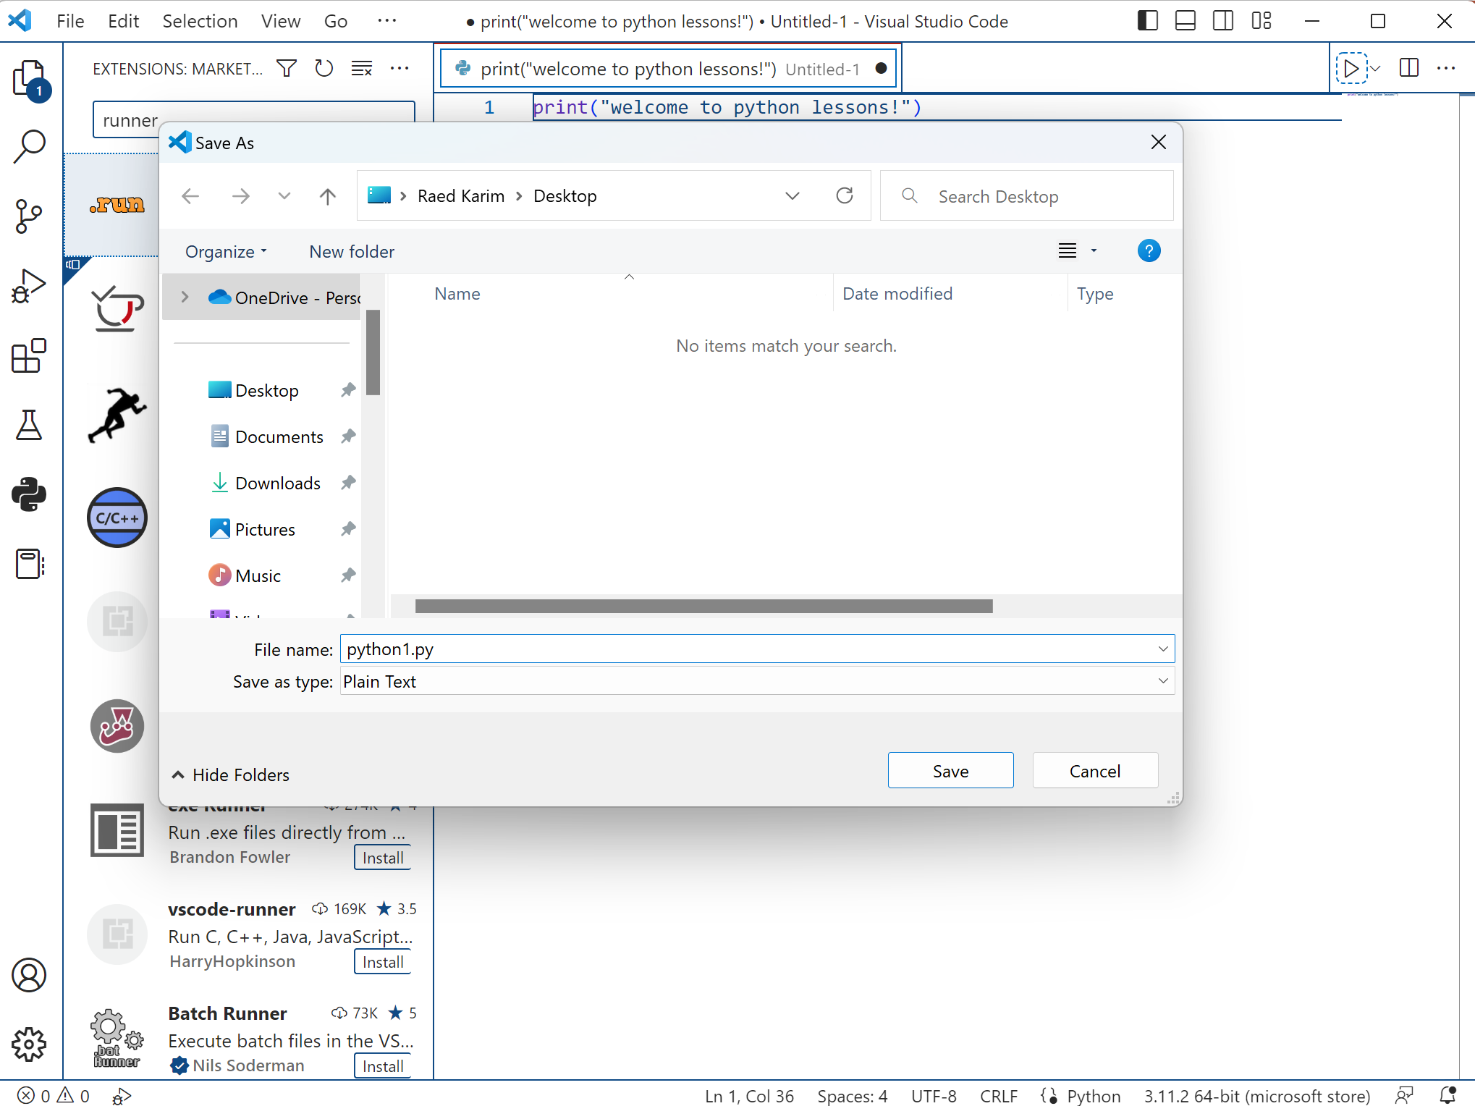
Introductions
Visual studio code downloads
Download visual studio code:
https://code.visualstudio.com/
In the next page:
Name the file with the extension
.py , then click Save..
You can choose where you
want to save your python
files on your computer
(e.g. Desktop).

Slide 64
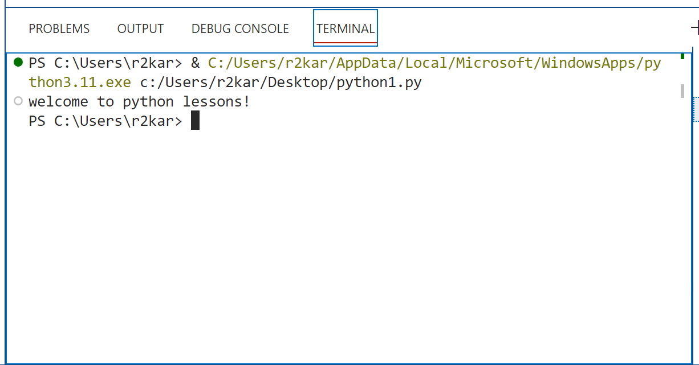
Introductions
Visual studio code downloads
Download visual studio code:
https://code.visualstudio.com/
Next, run the code by clicking on the
runner icon, the output is displayed
In the TERMINAL as shown in the screen.

Slide 65
Writing your first python program (using visual studio code) Part - 5

Slide 66
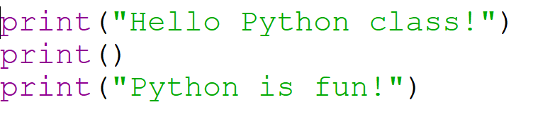
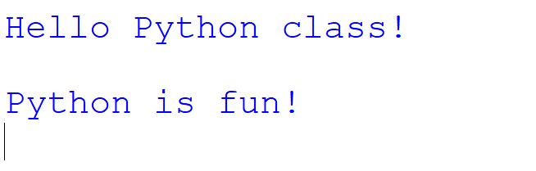
Introductions
Program 1: printing message to the console
output

Slide 67
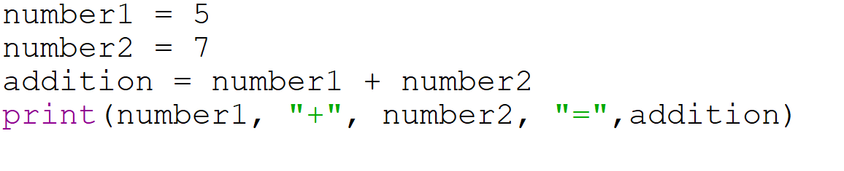
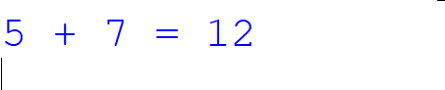
Introductions
Program 2: adding two numbers and printing the result
output

Slide 68
Introductions
Another editor to write python programs:
When you downloaded python interpreter, the python editor (IDLE – Integrated Development Learning Environment) also downloaded on your computer for you to use to write, execute and debug your python programs.
The python IDLE is an easy to use tool but is limited compared to the IDEs (e.g. VS code), that’s why programmers prefer using IDEs.
The IDLE has an interactive shell. This shell makes it easy to enter and test Python statements without writing full programs. This is another feature that makes Python work so well as a first programming language.

Slide 69
Introductions
Another editor to write python programs:
How to use the interactive shell?
Enter Python code after the >>> prompt. Then, press Enter.
If you enter valid code that produces a result, the shell displays the results.
If you enter invalid code, the shell displays an error message.

Slide 70
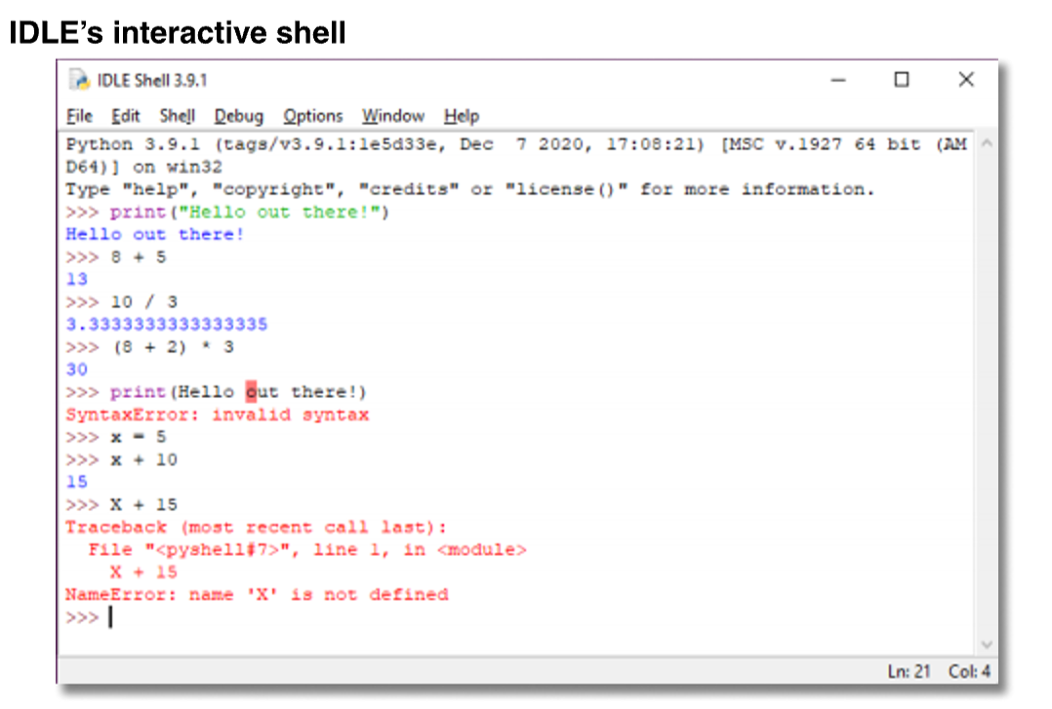
Introductions
Another editor to write python programs:
How to use the interactive shell?

Slide 71
Introductions
Another editor to write python programs:
How to create, open, save, and close source files?
Use the File menu and common techniques for your operating system.
How to switch between a source file window and its shell window?
Use the Window menu. Or, arrange the windows on your screen so both are visible, and then click on the window you want to use.
How to enter and edit Python code.
Use the Edit and Format menus, common editing keystrokes, and context menus.

Slide 72
Introductions
Another editor to write python programs:
How to compile and run a Python program?
From the editor window, press the F5 key or select Run Run Module.
If IDLE displays a dialog box that indicates that you must save the program first, press the Enter key or click OK to save it.
Then, if the program doesn’t have any errors, IDLE runs the program in the interactive shell.

Slide 73
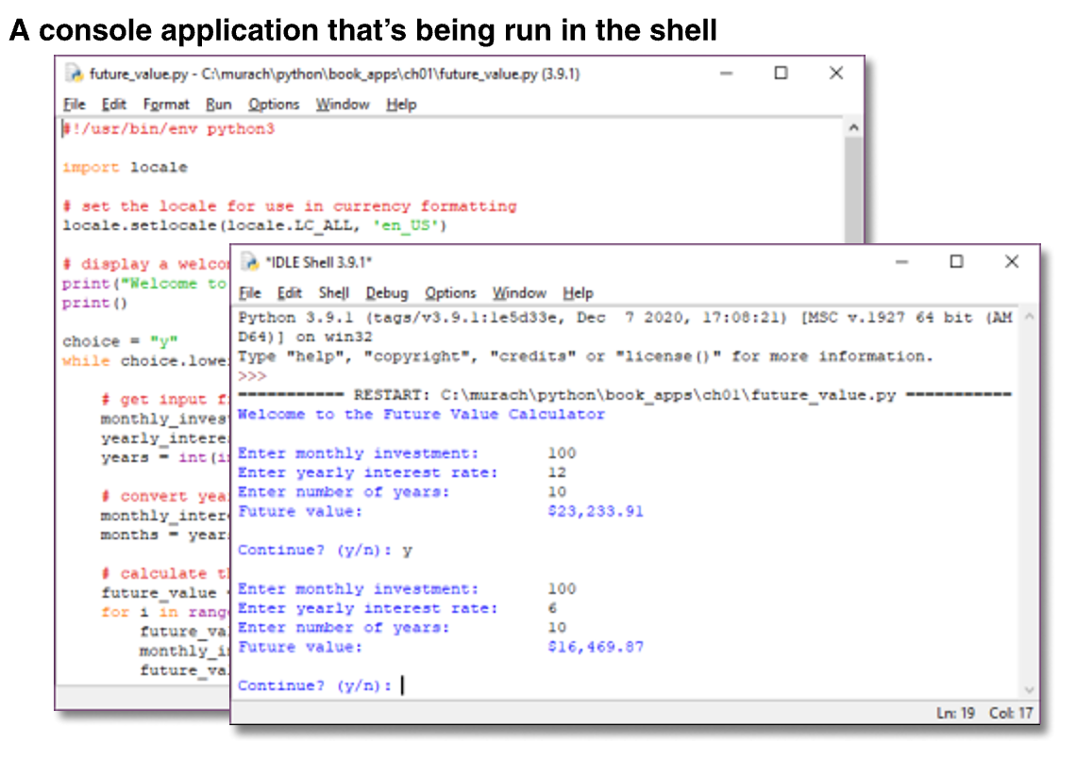
Introductions
Another editor to write python programs:

Slide 74
Introductions
A great resource to understand and create computer programs in Python:
https://runestone.academy/ns/books/published/fopp/GeneralIntro/intro-TheWayoftheProgram.html#learning-goals

Slide 75
Thank You

Slide 76
References
Material has been taken from (can be accessed through Sheridan's Library Services) :
Starting Out with Python (ISBN-13: 9780136912330 ):
https://www.pearson.com/en-ca/subject-catalog/p/starting-out-with-python/P200000003356/9780136912330
Murach’s Python 2nd Edition programming, 2nd Edition :
https://bookshelf.vitalsource.com/reader/books/9781943872756/pages/recent
Introducing Python, Lubanovic, B., O'Reily Media, 2nd Edition, 2019
https://www.oreilly.com/library/view/introducing-python-2nd/9781492051374/

